Slide 1
Software and Input Values This paper illustrates the application of a neural network using the Windows version of C#. The training and tests values employed as exemplars within this paper were obtained from a study originally conducted by Tovar and Torres (2012) and replicated by Vernucio and Debert (2016). The feedforward backpropagation algorithm that operates within the EVA application was originally developed and described by McCaffrey (2015); also, refer to Haykin (2009) for a discussion. A functional/beta Windows version of EVA (with training and test values) is downloadable for academic researchers.

Slide 2
The EVA application is enclosed within a zipped/compressed folder in conjunction with training data and test data files. The current version of EVA runs on most Windows operating systems; however, before running the current Windows version of EVA, some Windows machines may require the installation of a freely available Microsoft program: http://go.microsoft.com/fwlink/?LinkID=145727&clcid=0x894 .
It is important to note that the user must right click and “extract all” prior to beginning the installation process. Subsequent to extraction, the user opens the EVA folder and clicks the EVA icon. If a Microsoft or other antivirus warning appears (and it will), researchers are advised to read the information below prior to installing and running the program.

Slide 3
The current beta version of this application was designed to run on Windows 7 through 10 operating systems (a Mac OS version is in progress). All versions of the neural network system are and will remain freely accessible to interested academic users; however, the current beta version of EVA is designed for academic research and demonstration purposes only. The authors and journal (The Behavior Analyst) assume no liability for any damages associated with using, modifying, or distributing this program. The program has not been extensively field tested with input values (datasets) beyond those described in this paper.
This program is made available to interested educators/researchers without cost and without any warranties or provision for support. The authors and journal assume no responsibility or liability for the use of the program or provide any certification, license or title under any patent, copyright or government grant. The authors and journal make no representations or assurances with regard to the security, functionality, or other components of the program. There are unidentifiable hazards associated with installing and running any software application, and users/researchers are responsible for determining the extent to which this program is compatible with the computer and other software currently installed on the user’s computer.

Slide 4
The EVA application is enclosed within a zipped/compressed folder in conjunction with training data and test data files.
The entire zipped folder must be downloaded “intact.”
Subsequent to downloading the zipped folder, the user right clicks the folder and selects “extract all”

Slide 5
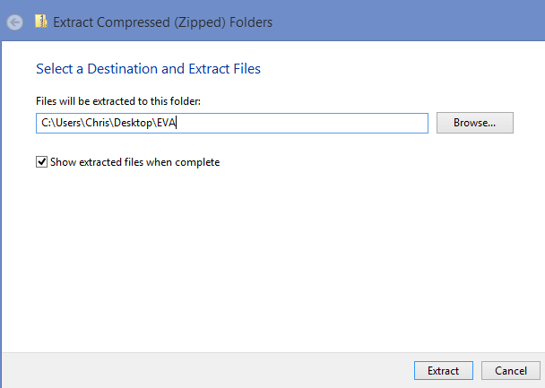
Upon right clicking the zipped folder, the “select a Destination and Extract Files” window will appear

Slide 6
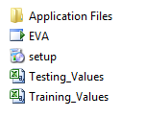
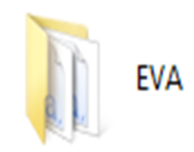
When the contents of the zipped folder have been successfully extracted, the files will be located within a new “standard folder” as shown below.
Open the new/standard EVA folder.
Double clicking the EVA icon initiates the instillation process.
Double click the EVA icon

Slide 7
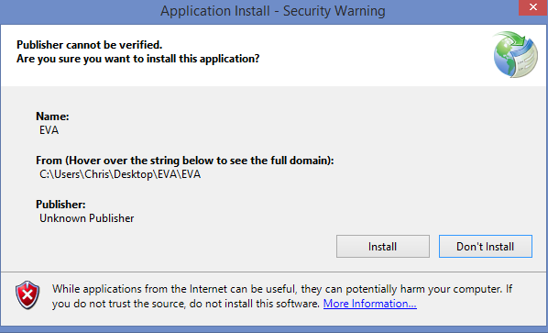
Application install – Security Warning will appear If the user wants to install the program, the “install” button must be clicked.

Slide 8
Another Microsoft message will appear. If the user wants to install the program, the “Run anyway” button must be clicked.

Slide 9
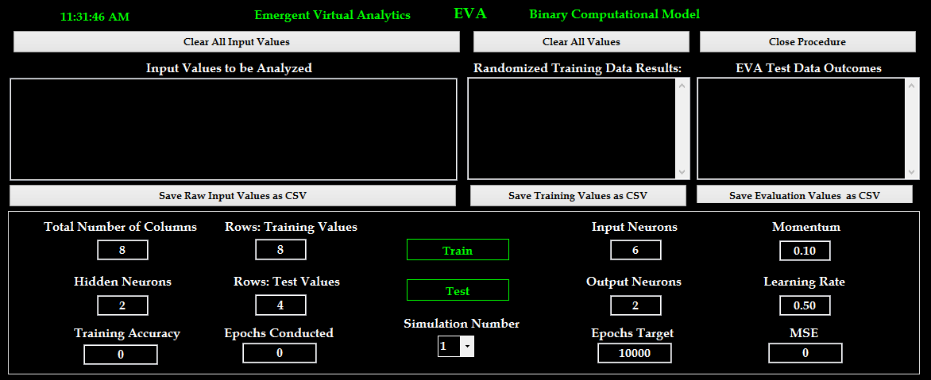
The EVA artificial neural network application will open.
Concurrently, the EVA application will be installed on the user’s computer.
See appendix for details on conducting a CM Analysis with Training and Test Stimuli

Slide 10
Slide References
Haykin, S. O. (2009). Neural networks and learning machines (3rd ed.). Upper Saddle River, NJ: Pearson Education.
McCaffrey, J. (2015). Coding neural network back-propagation using C#. Retrieved from https://visualstudiomagazine.com/articles/2015/04/01/back-propagation-using-c.aspx
Tovar, A. E., & Torres, A. (2012). A connectionist model of stimulus class formation with a yes-no procedure and compound stimuli. The Psychological Record, 62, 747-762. doi: 10.1007/s40732-016-0184-1
Vernucio, R. R., & Debert, P. (2016). Computational simulation of equivalence class formation using the go/no-go procedure with compound stimuli. The Psychological Record, 66, 439-440. doi:10.1007/s40732-016-0184-1

